Slide 1
CSCE 3600 Principles of Systems Programming Linux Overview
University of North Texas

Slide 2
Linux Command Structure
Linux command is an executable program
Interacts with operating system, including kernel and shell
Performs requested function(s) called for by user
Can be built-in shell command, executable shell script, or executable from compiled source code
Multiple commands executed one after another with ";"
command [option1 … optionM] [argument1 … argumentN] E.g.: echo hello
Command Name
Name of command, add "./" prefix if exists in current directory
Options
Optional switches to indicate mode of operation, usually – or – –
Arguments
Optional data being used or manipulated, such as the filename
https://phoenixnap.com/kb/echo-command-linux

Slide 3
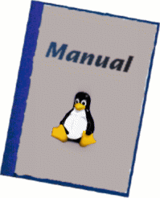
Command Help
Manual Pager
Use man <command> to find information about command
Each man page consists of several sections based on information it contains
See man man for a list of sections
Section 1 Executable programs or shell commands
Section 2 System calls
Section 3 C library calls
Section 4 Special Files
Section 5 File formats and conventions
Section 6 Miscellaneous
Section 7 sysadmin commands and daemons ....
Use man n <command>, where n = 1 to 9

Slide 4
Command Help (cont’d)
GNU Info System
Use info [command] to find information about command
Then can use arrow keys on keyboard to navigate the page and hit ENTER to go to link location of cursor
Other keystrokes n (next), p (previous), or t (top) to move to logical node
Command Help Option
Use – –help option for usage information about command

Slide 5
Basic Commands
File and Directory Related Commands
ls list the directory contents
cd change the working directory
pwd print the name of the working directory
mkdir create a new directory
cp copy a file and directory
mv move or rename a file or directory
rm remove a file or directory
rmdir remove an empty directory
file determine the file type
touch change file timestamp or create empty file if not exist
wc print number of lines, words, and characters in a file
sort sort lines of a file numerically or alphabetically

Slide 6
Basic Commands
Process Related Commands
ps print snapshot of current processes
top display dynamic view of running processes
netstat print network statistics
pstree print a tree of processes
kill send a signal to terminate a process
User Related Commands
who display current users logged on the system
whoami print effective userid (actually, identify current user)
groups print the groups that the user is in

Slide 7
Basic Commands
Search Related Commands
which locate a command
whereis locate the binary, source, & man page files for a command
find search for files in a directory hierarchy
find . –name "*.txt" –print
find ~/ –name "*.o" –exec chmod +x { } \;
locate find files by name
grep print lines matching to a pattern using regular expressions
grep –i "param" test.c
more test.c | grep "param"
Remember that you can use man or info to look up these powerful commands!!

Slide 8
Basic Commands
File Viewing Commands
cat concatenate files and print to standard output (terminal)
cat file1
cat file1 file2 file3
echo print a line of text
type print a brief description of a command
more file viewer for paging through text on screen at a time
less file viewer similar to more, but with more features
head print the first n lines of a file
tail print the last n lines of a file
diff compare files line-by-line

Slide 9
Basic Commands
Time Related Commands
date print date and time in various formats
cal print calendar for month and year
cal 1 2019
cal 9 1752
Disk Related Commands
df print file system disk space usage
du estimate file space usage for directory and all subdirectories
Miscellaneous Commands
clear clear the terminal screen
sleep delay (i.e., does nothing) for a specified amount of time
history print history of recently used commands

Slide 10
File Management
A file is a collection of related information, defined by its creator
E.g., source code, binary files, data, …
With respect to files, the OS is responsible for:
File creation and deletion
Directory creation and deletion
Support of primitives for accessing and manipulating files and directories
File security
Mapping files onto secondary storage
Hiding differences between storage types

Slide 11
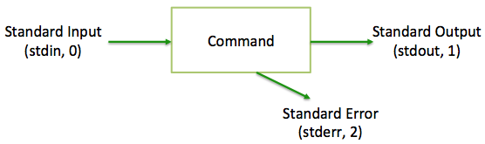
Standard Linux Files
Linux views absolutely everything as files
There are default files associated with every shell where a command reads its input from and sends its output and error messages to
These three files known as standard files for the command
stdin standard input default = keyboard
stdout standard output default = terminal
stderr standard error default = terminal
File descriptor is unique, non-negative integer used to identify open files on a per-process basis

Slide 12
File & Directory Permissions
Based on groups and types
Permission group indicates who can access the file
Permission type indicates what kind of access that user has to the file
Supported permission groups
User
Often called the owner, applies exclusively to owner of the file
Group
Applies only to the group assigned to file, but not the owner
Others
Often referred to as world, applies to all other users in the system, but not the owner or the group

Slide 13
File & Directory Permissions (cont’d)
Supported permission types
Read
Read permission, r, refers to the user’s capability to read the contents of the file
Write
Write permission, w, refers to the user’s capability to write to a file or modify a directory
Execute
Execute permission, x, refers to the user’s capability to execute a file or view the contents of a directory

Slide 14
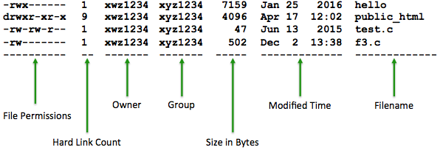
File & Directory Permissions (cont’d)
Linux controls the who and what access for files and directories using a permission list
Sequence of ten characters organized into four parts to the leftmost output of ls –l command
In computing, a hard link is a directory entry (in a directory-based file system) that associates a name with a file. Thus, each file must have at least one hard link.
https://www.ufsexplorer.com/articles/file-systems-basics/
Notes:
The maximum number of hard links to a single file is limited by the size of the reference counter. On Unix-like systems the counter is 4,294,967,295 (on 32-bit machines) or 18,446,744,073,709,551,615 (on 64-bit machines). In some file systems, the number of hard links is limited more strictly by their on-disk format.

Slide 15
File & Directory Permissions (cont’d)
Permission list
First column describes the type of file
d directory
– ordinary file
l symbolic link
s socket
p named pipe
c character device file (e.g., terminal)
b block device file (e.g., hard disk drive)
Most often, users see either – or d for ordinary files and directories

Slide 16
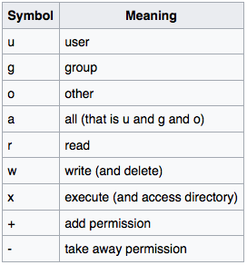

File & Directory Permissions (cont’d)
Permission list
Set file permissions using chmod command in either symbolic or absolute mode
Symbolic mode
Absolute mode
Uses combination of permission group, +/–, and permission type symbols in order to add or remove permissions
Uses octal (i.e., base 8) values to specify permissions

Slide 17

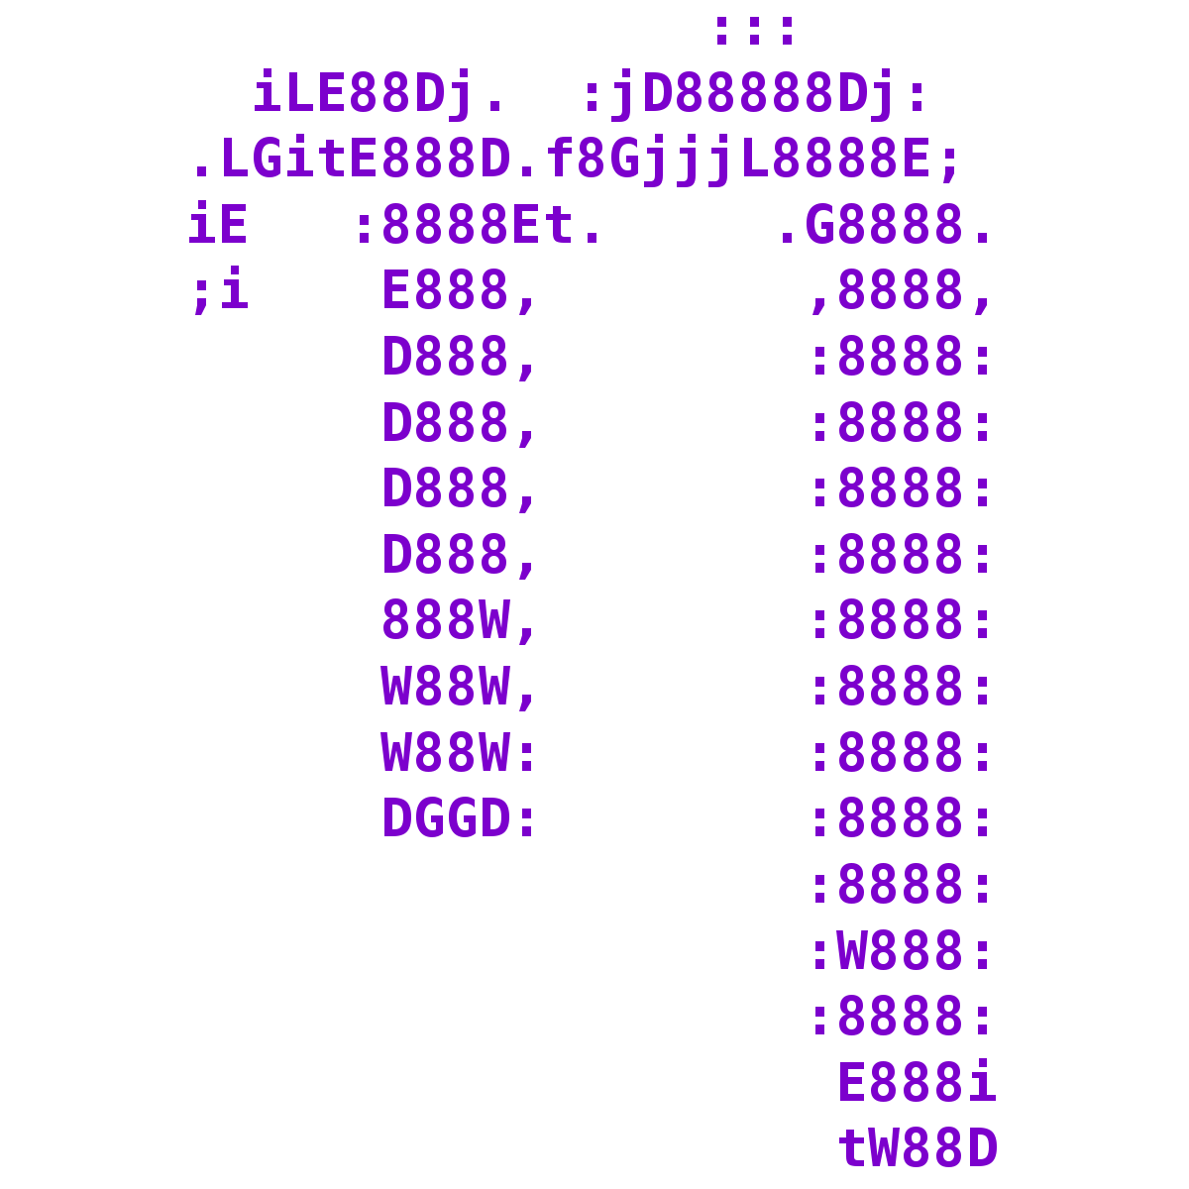
Linux File Editors
vim
vi is original text editor available on BSD Unix systems
vim is improved version on Linux systems
Supports two modes of operation: insert and command
nano
pico is text editor available as part of pine mail utility (pine e-mail composer)
nano is improved open source version on Linux systems

Slide 18
Input Redirection
Input redirection from file (i.e., read from file)
Input redirection accomplished by using the less than (<) symbol for the input file
This syntax will detach the keyboard from the standard input of the command and attach it to the input file
command < input_file
E.g., cat < sample
The sample file is the input file where the cat command reads from
The cat command takes input from the standard input if no file is passed as an argument

Slide 19
Output Redirection
Output redirection to files
The syntax is used to detach the display screen from the standard output of the command and attach the output file instead
command > output_file
E.g., cat > sample
When the command is executed, it creates a file called sample whose contents are whatever you type on the keyboard until you press <CTRL-D>
E.g., grep "abc" student > abc_file
This command sends all lines in the student file that contains the string "abc" to a file called abc_file
Be careful as '>' will overwrite files! You can use '>>' to append output to a file instead.

Slide 20
Input and Output Redirection
Combined input and output redirection
command < input_file > output_file
E.g., cat < sample > sample1
This command takes its input from the file sample and sends it output to the file sample1

Slide 21
Pipes
The Linux system allows the output of a command to be connected to the input of another command
A pipe is a method of interprocess communication (IPC)
Accomplished using the pipe character: |
A pipeline is a set of processes chained by their standard streams, so that the output of each process (i.e., stdout) feeds directly as input (i.e., stdin) to the next one
command1 | command2 | … | commandN
who | sort | grep "2024" > myfile
This command sorts the output of the who command and sends the lines containing "2024" to a file called myfile
ls –l |less

